Slide 1

Anxiety
Alka Johnson, DSC530-T301 (2253-1)
2.28.2025

Slide 2
Subject of Analysis
Medication vs. Lifestyle
My original statistical question explores the effects medication has on the severity of anxiety compared to different lifestyle choices made. From this original question, the following came:
How do I measure anxiety?
What would be considered a significant change in the severity of anxiety?
How many lifestyle factors do I consider?
What impact may medication and lifestyle choices have on each other that can affect this research
i.e., alcohol can block the effectiveness of medication

Slide 3

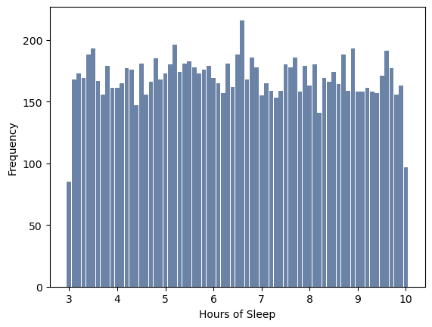
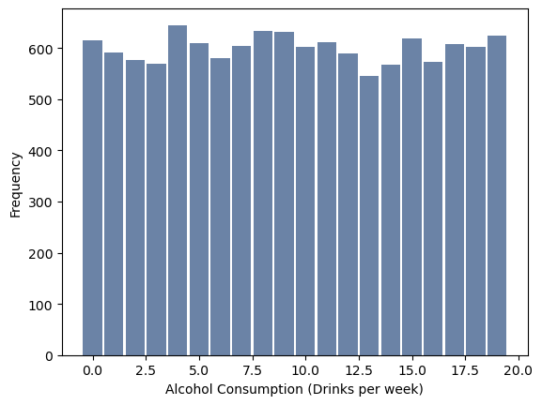
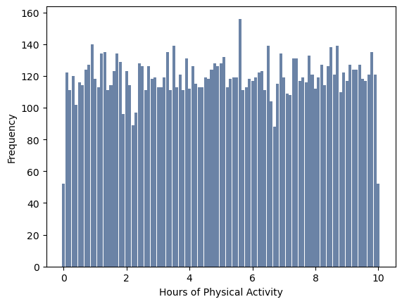

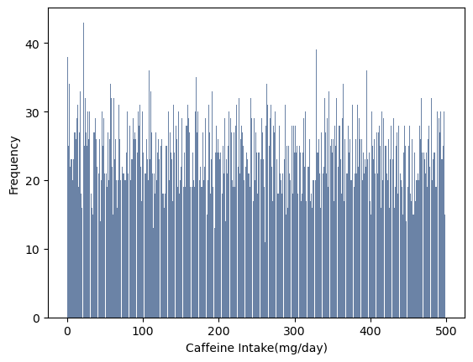
Factors
Alcohol Consumption: Drinks/week
Caffeine Consumption: MG/day
Sleep: Hours/night
Physical Activity: Hours/week
Notes:
My most used factors are alcohol consumption and caffeine intake. I chose these two because I am most personally interesting in the effects alcohol has on anxiety and caffeine’s large variance.

Slide 4
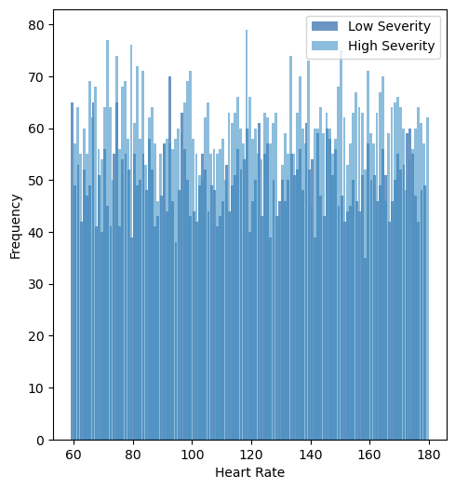

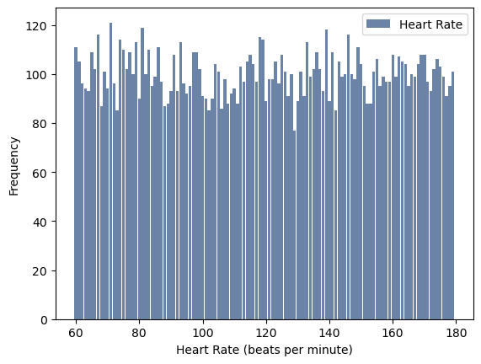

Symptoms
The bottom histogram shows the frequency of different heart rates
The top histogram breaks this down into high severity and low severity
This is to analyze whether high severity is more associated with a higher heart rate and vice versa
Notes:
Because dizziness and breathing rate were not strong quantitative variables they were not included.

Slide 5
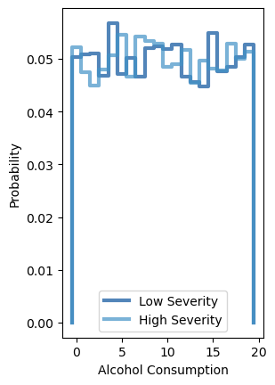
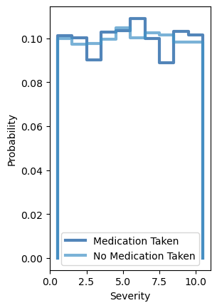
Probability Mass Function
There are two significant dips in probability for medication around 2.5 and 7.5 of severity
There are spikes in the probability of low severity around 5 and 15 drinks. Regarding high severity, you see this increase right in between 5 and 10 and again near 17

Slide 6
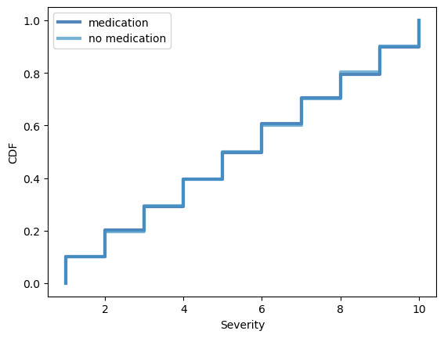
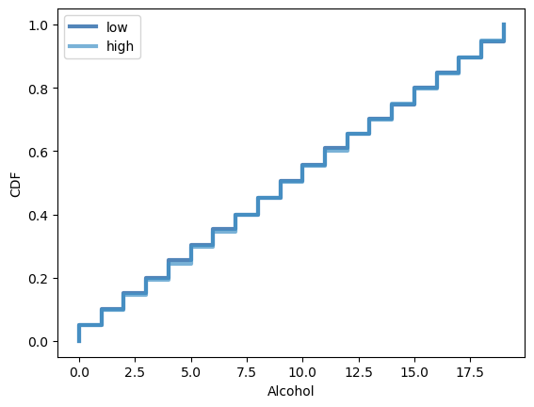
Medication vs. Alcohol
Notes:
The highlighted sections show where there is a bit of deviation between medication taken vs. no medication and low severity vs. high severity. For severity, 0.2 and 0.6 shows no medication is slightly lower than medication while at 0.8 it slowly increases above medication. For alcohol, all three highlights show high severity slightly lower than low severity.

Slide 7
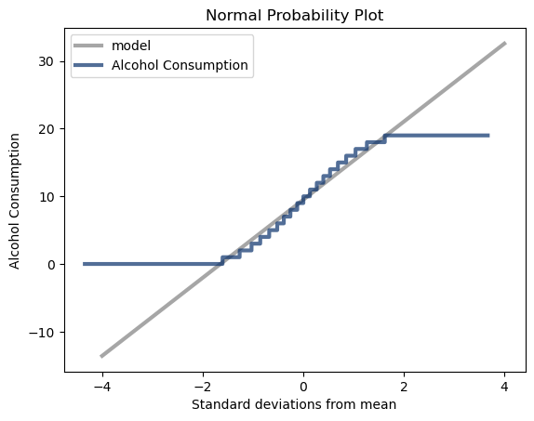
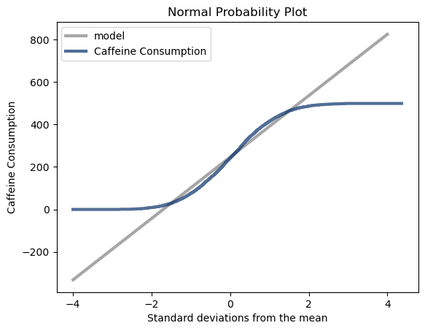
Data Distribution
The probability plot shows how closely the data aligns with normal distribution.
Because caffeine has more datapoints its line is smoother, but the distribution shapes are closely aligned

Slide 8
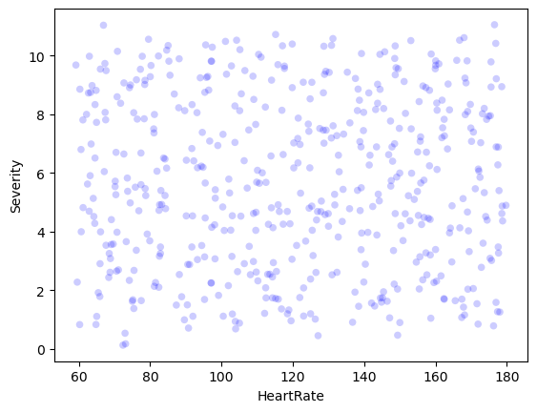
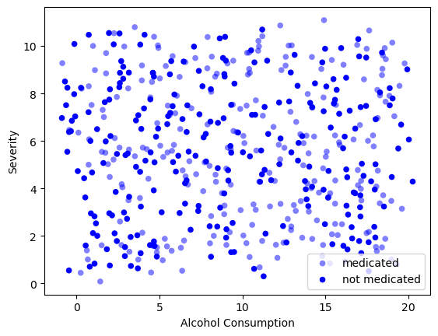
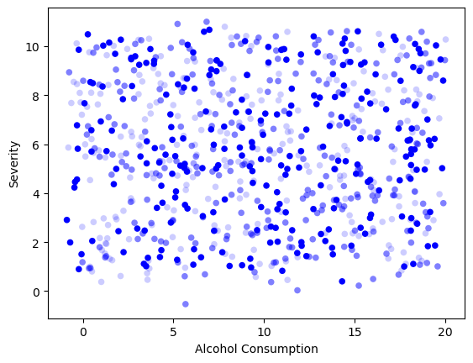
Correlation
The measurement of relationship between two variables
Notes:
When working with the scatterplot I originally tried using samples vs. the full population to see what the difference would look like. The population tends to give me a lower relationship. Both scatterplots suggest very little relationship between the variables and the associated covariances is in line with this.

Slide 9
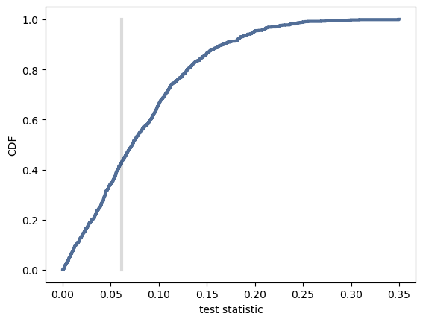
Hypothesis Test
Choose
Choose a test statistic
Difference in means = .016
Compute
Compute the P-Value
P-Value = .57
Define
Define the null hypothesis
Alcohol Consumption has no effect on severity
Interpret
Interpret the results
Fail to reject the null hypothesis
Notes:
My original belief about the population is that low severity population would result in a significantly lower average alcohol consumption that the high severity population.

Slide 10
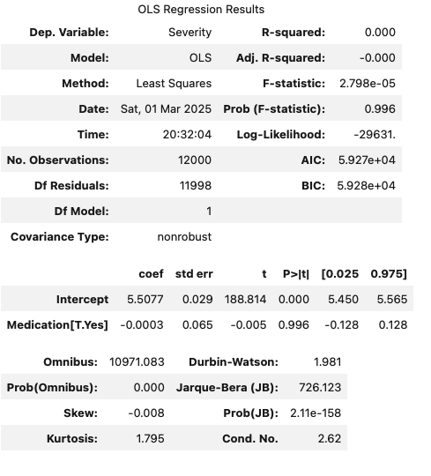
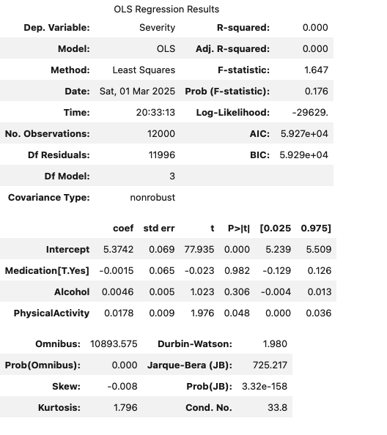
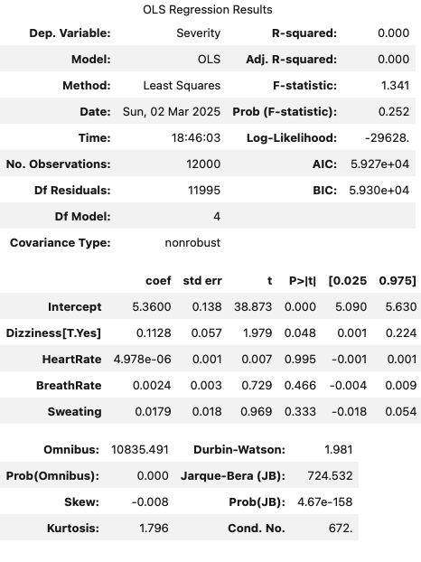
Regression Analysis
Notes:
All three regression analysis did not result in st

Slide 11

Final Thoughts
The Data
Medication – MG of dosage and how long medication had been taken would have been helpful datapoints
Clearer understanding of what consisted of a severe anxiety attack would have also been helpful
The Tools
Better understanding of sample vs. population
Better understanding of analysis output
Better understanding of the code

